Slide 1
Learning Objective
I will be able to solve simultaneous linear and quadratic equations
Success Criteria
At the end of the lesson, I will be able to:
Solve simultaneous linear and quadratic equations

Slide 2
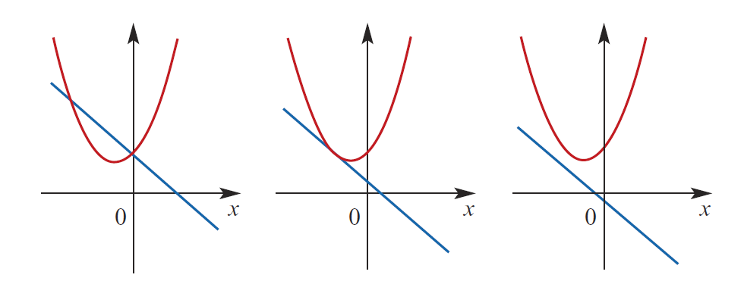
Concept Development – solve graphically
Determine the number of point of intersection(s):
2
1
0

Slide 3
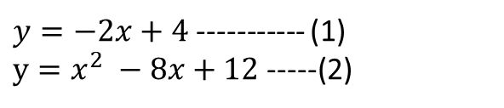
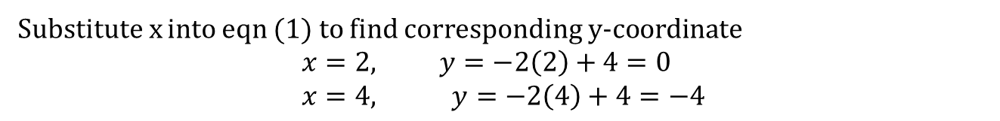
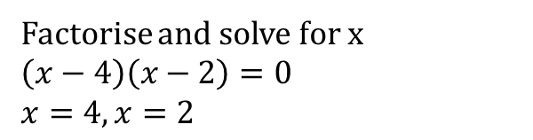
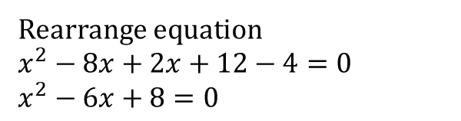
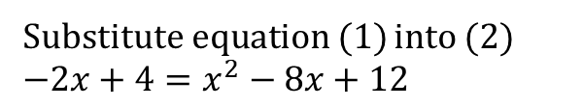
Cambridge Ch 3J - Example
Find the points of intersection of the line with equation $y=−2x+4$ and the parabola with equation $y=x^{2} −8x+12$
$y=−2x+4$ ----------- (1)
$y=x^{2} −8x+12$ -----(2)
Substitute equation (1) into (2)
$−2x+4=x^{2}−8x+12$
Rearrange equation
$x^{2}−8x+2x+12−4=0$ $x^{2}−6x+8=0$
Factorise and solve for x
$\left(x−4\right)\left(x−2\right)=0$ $x=4, x=2$
Substitute x into eqn (1) to find corresponding y-coordinate
$$x=2, y=−2\left(2\right)+4=0 \\ x=4, y=−2\left(4\right)+4=−4$$
Point of intersection are (2, 0) and (4,-4)

Slide 4
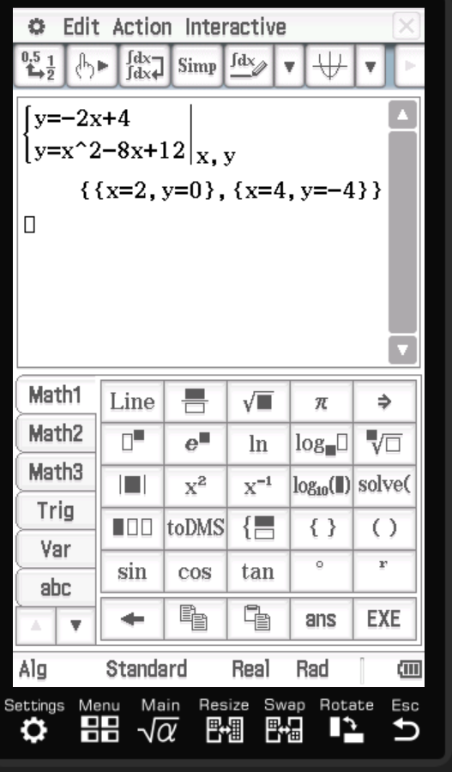
Cambridge Ch 3J - Example
Find the points of intersection of the line with equation $y=−2x+4$ and the parabola with equation $y=x^{2} −8x+12$
$y=−2x+4$ ----------- (1)
$y=x^{2} −8x+12$ -----(2)
Substitute equation (1) into (2)
$−2x+4=x^{2}−8x+12$
Rearrange equation
$x^{2}−8x+2x+12−4=0$ $x^{2}−6x+8=0$
Factorise and solve for x
$\left(x−4\right)\left(x−2\right)=0$ $x=4, x=2$
Substitute x into eqn (1) to find corresponding y-coordinate
$$x=2, y=−2\left(2\right)+4=0 \\ x=4, y=−2\left(4\right)+4=−4$$
Point of intersection are (2, 0) and (4,-4)

Slide 5
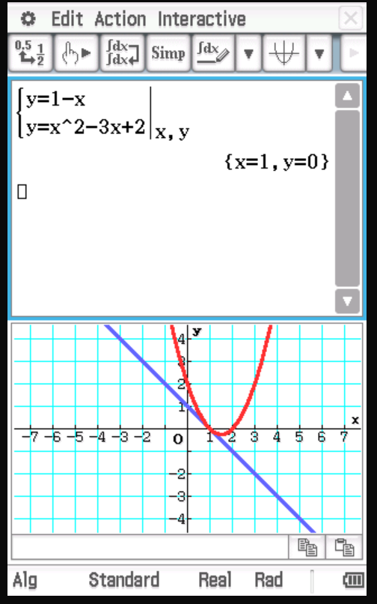
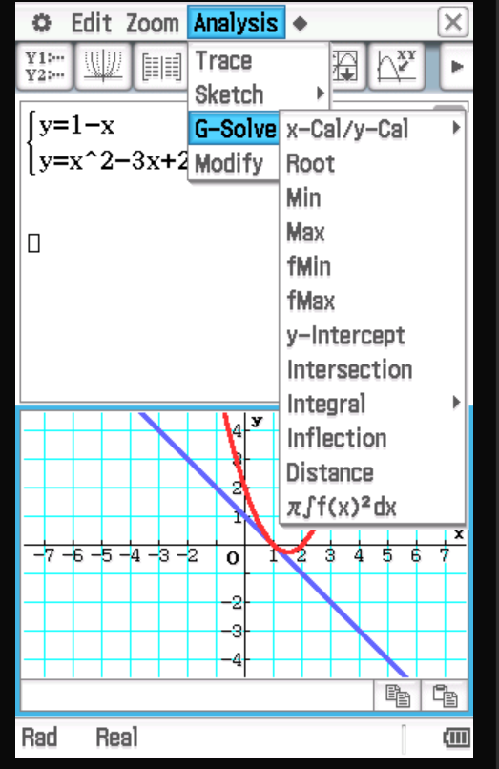
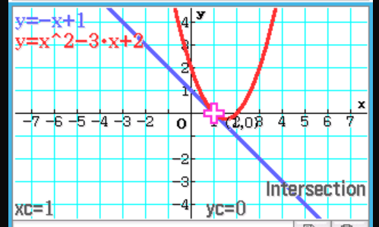
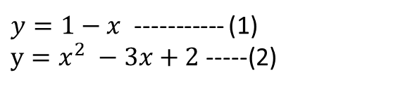
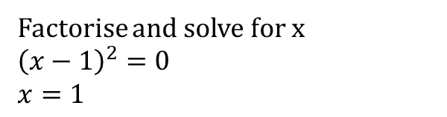
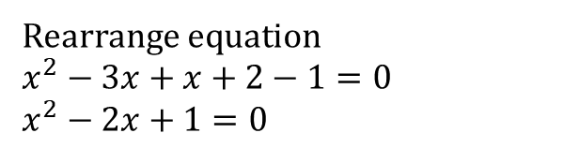
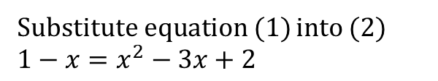
Cambridge Ch 3J - Example
Prove that the straight line with the equation $y=1−x$ meets the parabola with the equation $y=x^{2}−3x+2$ once only
$y=1−x$ ----------- (1)
$y=x^{2} −3x+2$ -----(2)
Substitute equation (1) into (2)
$1−x=x^{2}−3x+2$
Rearrange equation
$x^{2}−3x+x+2−1=0$ $x^{2}−2x+1=0$
Factorise and solve for x
${\left(x−1\right)}^{2}=0$ $$x=1$$
Substitute x into eqn (1) to find corresponding y-coordinate
$$x=1 y=1−1=0$$
Point of intersection are (1,0)

Slide 6
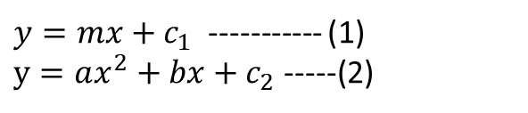
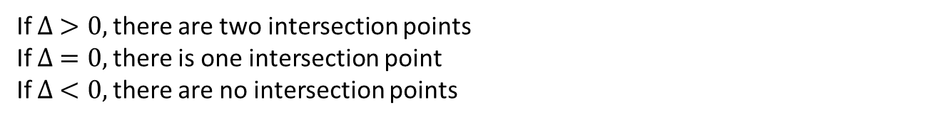
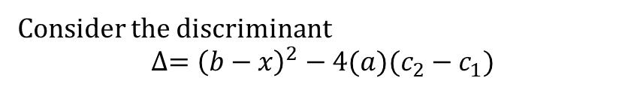
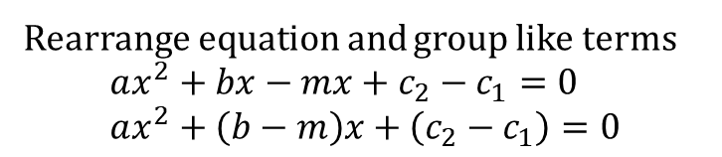
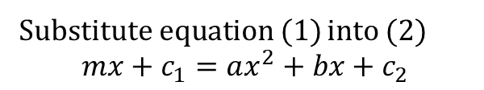
Determining number of intersection points
To determine how many points of intersection between $y=mx+c_{1}$ and $y={ax}^{2}+bx+c_{2}$
$y=mx+c_{1}$ ----------- (1)
$y=ax^{2}+bx+c_{2}$ -----(2)
Substitute equation (1) into (2)
$$mx+c_{1}=ax^{2}+bx+c_{2}$$
Rearrange equation and group like terms
$$ax^{2}+bx−mx+c_{2}−c_{1}=0 \\ ax^{2}+\left(b−m\right)x+\left(c_{2}−c_{1}\right)=0$$
Consider the discriminant
$$∆={\left(b−x\right)}^{2}−4(a)(c_{2}−c_{1})$$
If $∆ >0,$there are two intersection points
If $∆ =0,$there is one intersection point
If $∆ <0,$there are no intersection points

Slide 7
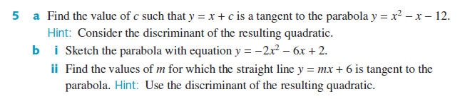



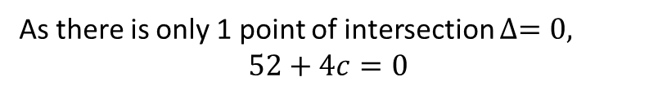
Cambridge Ex 3J Q5
a) Tangent to the graph = 1 point of intersection
Equate the 2 equations together,
$$x+c=x^{2}−x−12$$
$$x^{2}−x−x−12−c=0$$
$$x^{2}−2x−12−c=0$$
$$∆={\left(−2\right)}^{2}−4\left(1\right)\left(−12−c\right)$$
$$∆=4+48+4c$$
$$∆=52+4c$$
As there is only 1 point of intersection $∆=0,$
$$52+4c=0$$
$$c=−\frac{52}{4}=−13$$

Slide 8





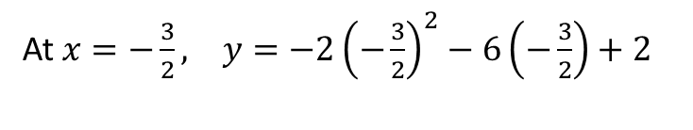




Cambridge Ex 3J Q5
b) $y=−2x^{2}−6x+2$
X-intercept $−2{\left(x+\frac{3}{2}\right)}^{2}+\frac{13}{2}=0$
Axis of symmetry $x=−\frac{−6}{2\left(−2\right)}=−\frac{6}{4}=−\frac{3}{2}$
$$2{\left(x+\frac{3}{2}\right)}^{2}=\frac{13}{2}$$
At $x=−\frac{3}{2}, y=−2{\left(−\frac{3}{2}\right)}^{2}−6\left(−\frac{3}{2}\right)+2$
$${\left(x+\frac{3}{2}\right)}^{2}=\frac{13}{4}$$
$$y=−2\left(\frac{9}{4}\right)+9+2 \\ =−\frac{9}{2}+11 \\ =\frac{13}{2}$$
$$x+\frac{3}{2}=\frac{± \sqrt{13}}{2}$$
$$x=\frac{−3± \sqrt{13}}{2}$$
Turning point$=\left(−\frac{3}{2}, \frac{13}{2}\right)$
Y-intercept $=\left(0,2\right)$

Slide 9
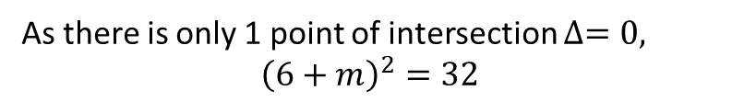


Cambridge Ex 3J Q5
c) Tangent to the graph = 1 point of intersection
Equate the 2 equations together,
$$mx+6={−2x}^{2}−6x+2$$
$$2x^{2}+6x+mx+6−2=0$$
$$2x^{2}+\left(6+m\right)x+4=0$$
$$∆={\left(6+m\right)}^{2}−4(2)(4)$$
$$∆={\left(6+m\right)}^{2}−32$$
As there is only 1 point of intersection $∆=0,$
$${\left(6+m\right)}^{2}=32$$
$$(6+m)=±\sqrt{32}$$
$$m=−6±\sqrt{32}$$

Slide 10

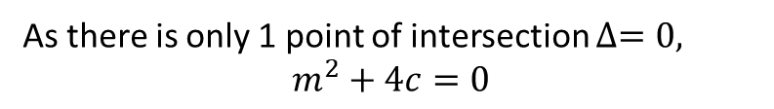
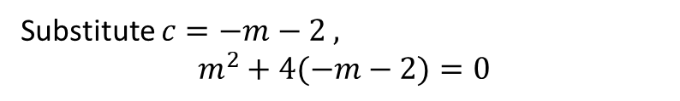





Cambridge Ex 3J Q9
Equation of the graph $y=mx+c$
S$ubstite x=1, y=−2, −2=m+c⇒c=−m−2$
$$\left(m−2+\sqrt{12}\right)\left(m−2−\sqrt{12}\right)=0$$
Equate the 2 equations together,
$$mx+c=x^{2}$$
$$m=2±\sqrt{12}=2±2\sqrt{3}$$
$$x^{2}−mx−c=0$$
When $m=2−2\sqrt{3}, c=−2+2\sqrt{3}−2,$
$$∆={\left(−m\right)}^{2}−4(1)(−c)$$
$$c=2\sqrt{3}−4$$
$$∆=m^{2}+4c$$
When $m=2+2\sqrt{3}, c=−2−2\sqrt{3}−2,$
As there is only 1 point of intersection $∆=0,$
$$m^{2}+4c=0$$
$$c=−2\sqrt{3}−4$$
$y=\left(2−2\sqrt{3}\right)x+2\sqrt{3}−4$ or $y=2\left(1−\sqrt{3}\right)x+2\sqrt{3}−4$
Substitute $c=−m−2 ,$
$$m^{2}+4(−m−2)=0$$
$y=\left(2+2\sqrt{3}\right)x−2\sqrt{3}−4$ or $y=2\left(1+\sqrt{3}\right)x−2\sqrt{3}−4$
$$m^{2}−4m−8=0$$
$${\left(m−2\right)}^{2}−12=0$$

Slide 11
Independent Practice
Cambridge Ex 3J

